Slide 1
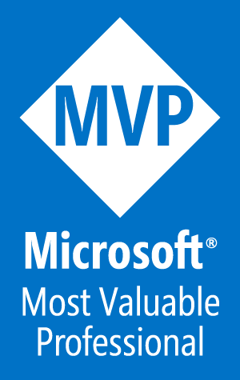

Azure AD SSO Deep Dive
Tim Warner
tim-warner@pluralsight.com
Notes:
DSC
Monday, May 22, 2017
11:45a – 12:45pm
AZURE AD SSO
Tuesday, May 23, 2017
10:00a – 11:00a
AZURE NETWORKING
3:00p – 4:00p
PAAS vs IAAS
4:30p – 5:30p

Slide 2

Learning Objectives
Understand the problem space
Study Azure AD identity management approaches
Review two synchronized identity case studies

Slide 3

Session Materials
timw.info/itt

Slide 4

The Problem Space

Slide 5
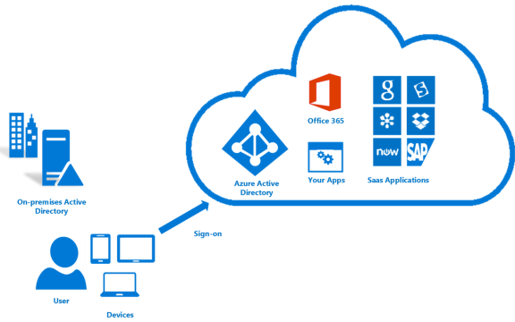
The Worst-Case Scenario
pat@company.com
P@$$word1
patrick.r.foley@companydotcom714.onmicrosoft.com
P@$$word2

Slide 6
Our Goals
User has to remember a single credential set
User can change password on-prem or in the cloud
Developers can scratch “identity management” off their list
IT operators have a more peaceful work life
© ITtransformation. All rights reserved.
http://www.ITtransformation.events

Slide 7
Azure Active Directory Quickstart

Slide 8
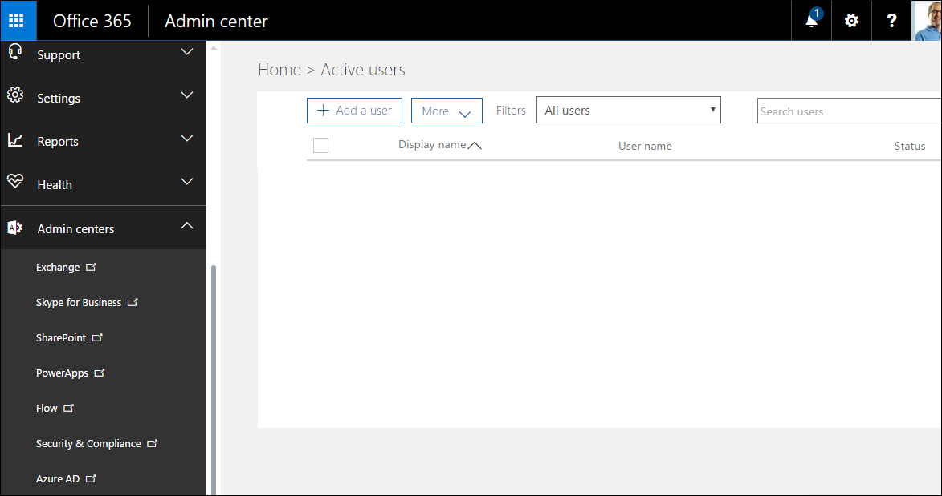
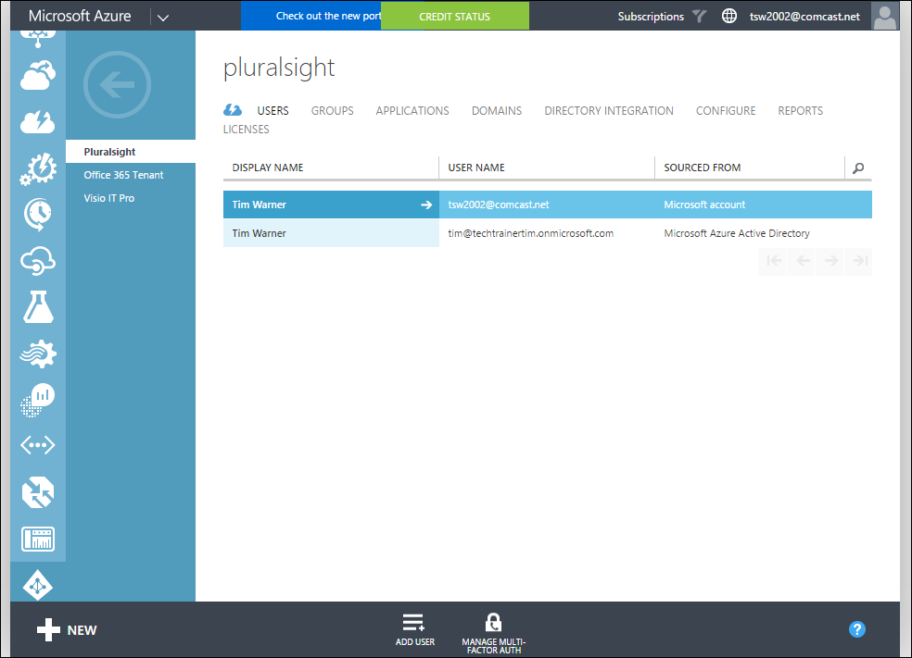
The Big "Secret" in Office 365
Azure AD is a multi-tenant cloud directory service, but is NOT the same as AD DS
© ITtransformation. All rights reserved.
http://www.ITtransformation.events

Slide 9

Azure AD Paid Editions
Basic
P1
P2
Corporate branding
Self-service password change
Security/usage reports
Password writeback
Microsoft Identity Manager (MIM)
Cloud app discovery
Identity protection (identify suspicious activity)
Privileged account management (JIT administrative access)
© ITtransformation. All rights reserved.
http://www.ITtransformation.events

Slide 10
Azure AD Product Family
Azure AD
The default offering
AAD DS
LDAP forest in the cloud
Azure AD B2C
Universal identity to your SaaS apps
Azure AD B2B
AD FS in the cloud
© ITtransformation. All rights reserved.
http://www.ITtransformation.events

Slide 11
Azure AD Identity Management Approaches

Slide 12

The Options
Cloud identity
Synchronized identity
Federated identity
Third-party IdP solutions

Slide 13
Cloud Identity
No synchronization
Users maintain two different credentials
Advantage: No on-prem infrastructure is needed
Pilot cloud identity, then migrate to synchronization
© ITtransformation. All rights reserved.
http://www.ITtransformation.events

Slide 14
Synchronized Identity
Two identities per user
Challenge: password synchronization
You need a custom DNS domain
Don't forget to assign O365 licenses to users
© ITtransformation. All rights reserved.
http://www.ITtransformation.events

Slide 15
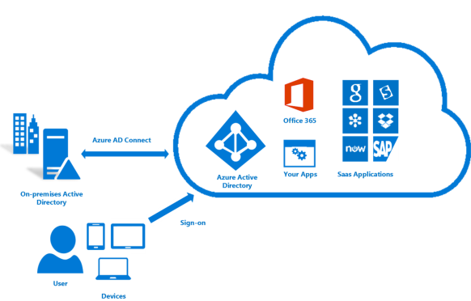
Synchronized Identity Architecture
user@company.com
Pa$$w0rd
Password writeback
user@company.com
Pa$$w0rd
© ITtransformation. All rights reserved.
http://www.ITtransformation.events
timw.info/adcon

Slide 16
Federated Identity
True SSO with on-premises AD credentials
Authentication takes place on-prem
Tokens: On-prem is ID provider; O365 Azure AD is relying party
Azure AD Premium has basic (generic) corporate branding
© ITtransformation. All rights reserved.
http://www.ITtransformation.events

Slide 17
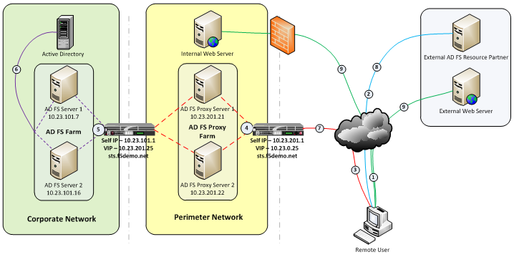
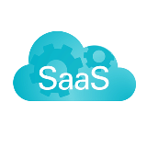
Federated Identity Architecture
*
*
*
*
timw.info/adfsarch
© ITtransformation. All rights reserved.
http://www.ITtransformation.events

Slide 18
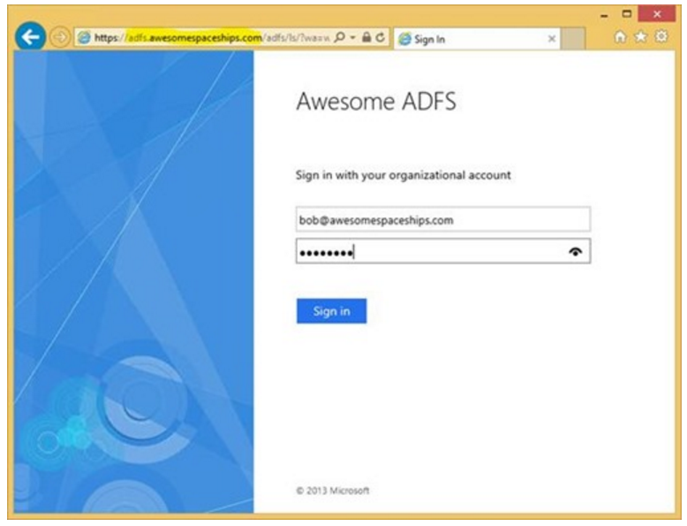
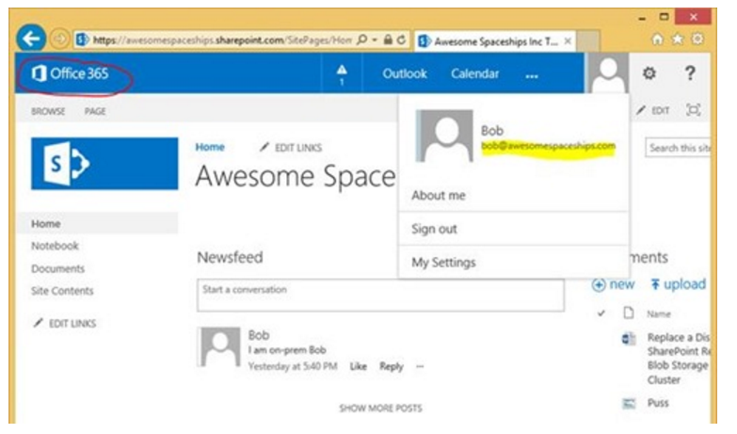
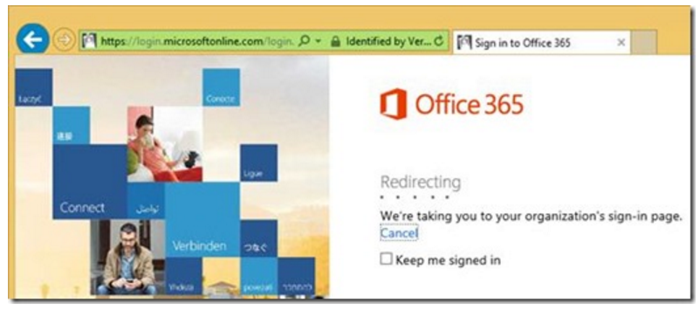
AD FS SSO Example
timw.info/sso2
© ITtransformation. All rights reserved.
http://www.ITtransformation.events

Slide 19
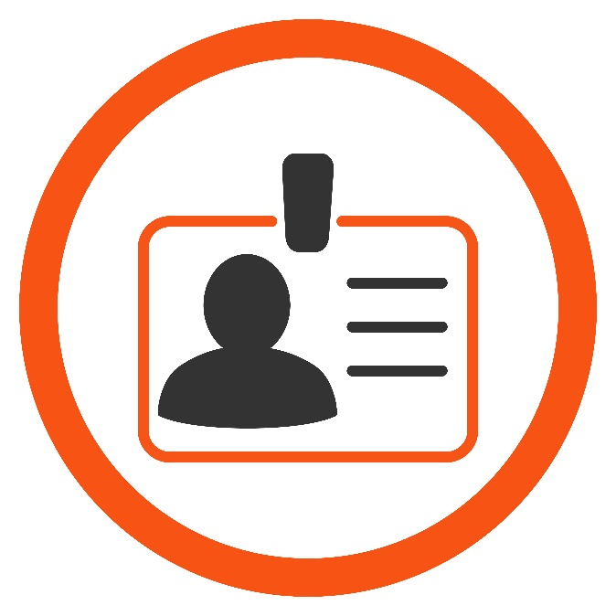
Third-Party IdP Options
Most options are open-source
Paid support tiers (a la Red Hat)
OpenID Connect / OAuth 2.0
IdentityServer
Shibboleth
WS02

Slide 20
Synchronized ID Example 1 of 2: On-Prem-to-Office 365

Slide 21
Password Sync Recipe
Add a custom DNS domain to the O365 Azure AD instance
Create TXT or MX records to verify ownership
(Maybe) add and configure UPN suffixes
AD Domains and Trusts MMC console
Enable directory synchronization in Azure AD
Consider Azure AD Premium for enhanced features
Install and run Azure AD Connect
Express or Custom setup
Troubleshoot errors
miisclient.exe (Synchronization Service Manager)
© ITtransformation. All rights reserved.
http://www.ITtransformation.events

Slide 22

Let’s Demo O365 Password Sync!

Slide 23
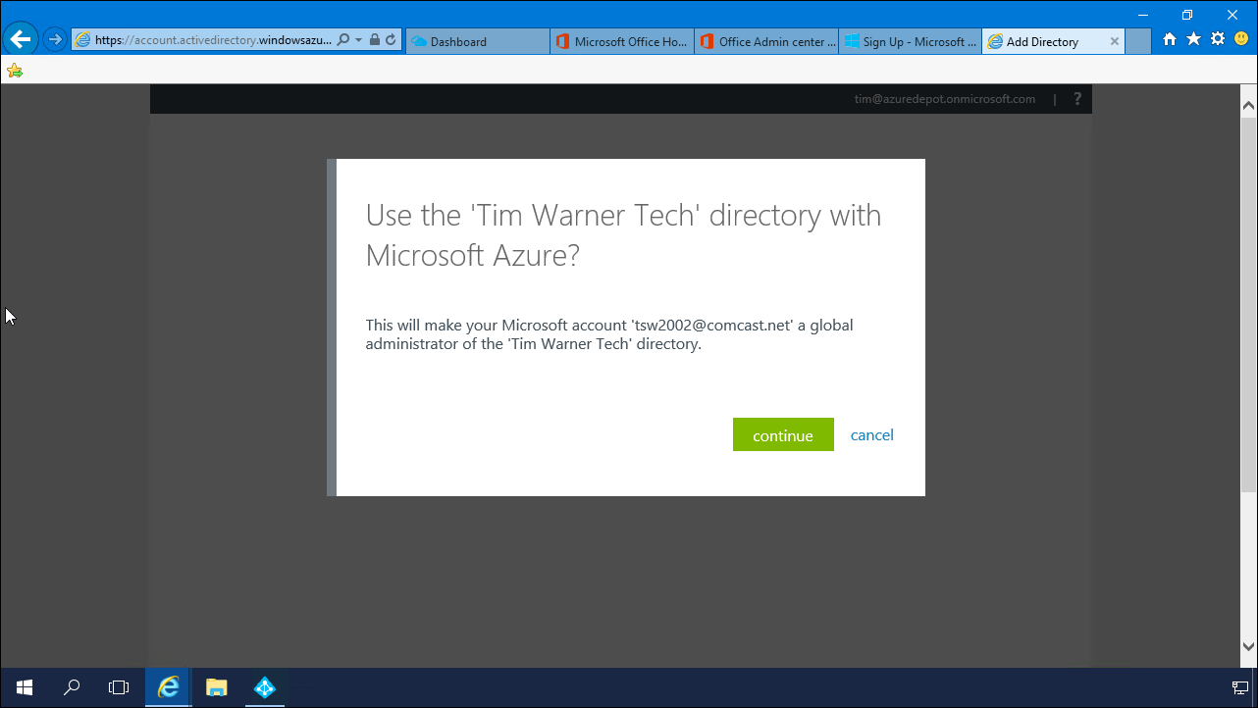
You can manage you O365 Azure AD instance from within your existing Azure subscription

Slide 24
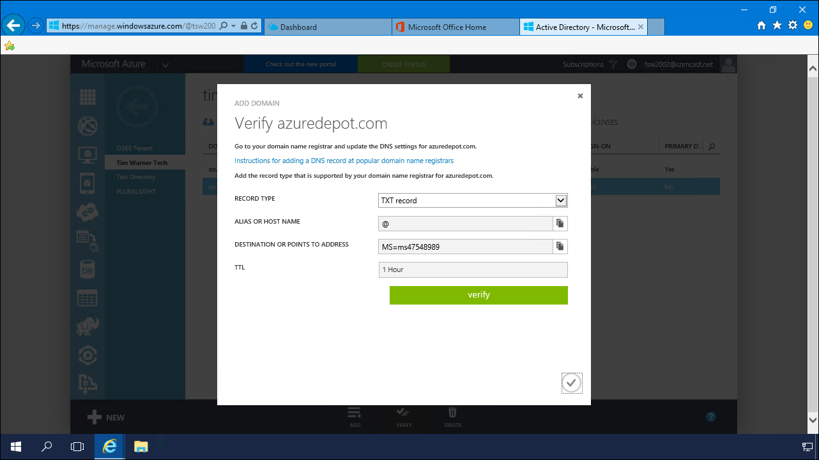
You need to verify that you own your custom DNS domain

Slide 25
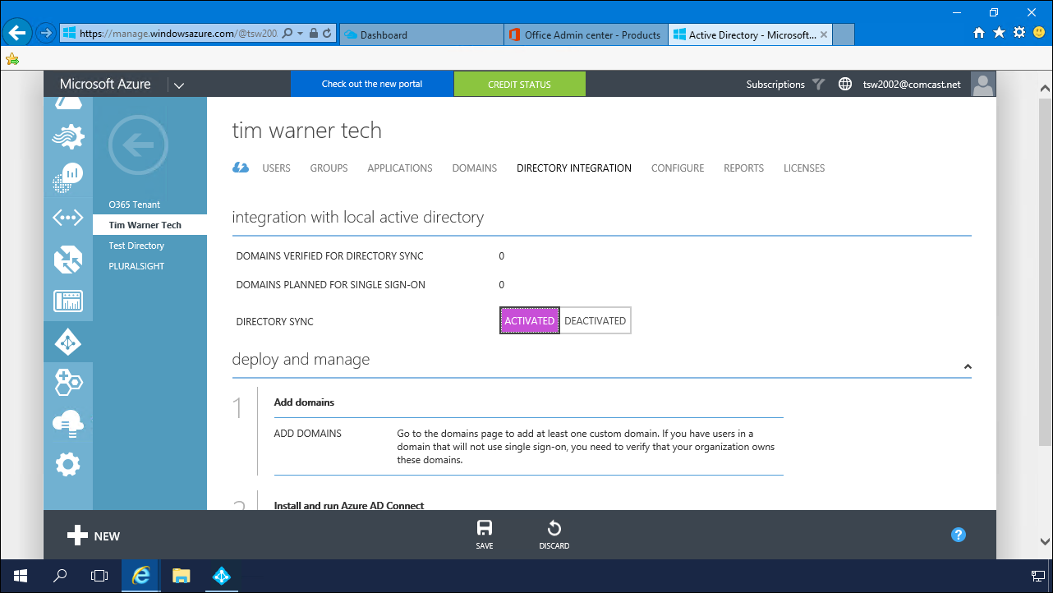
Now would be a good time for a demo *ahem*

Slide 26
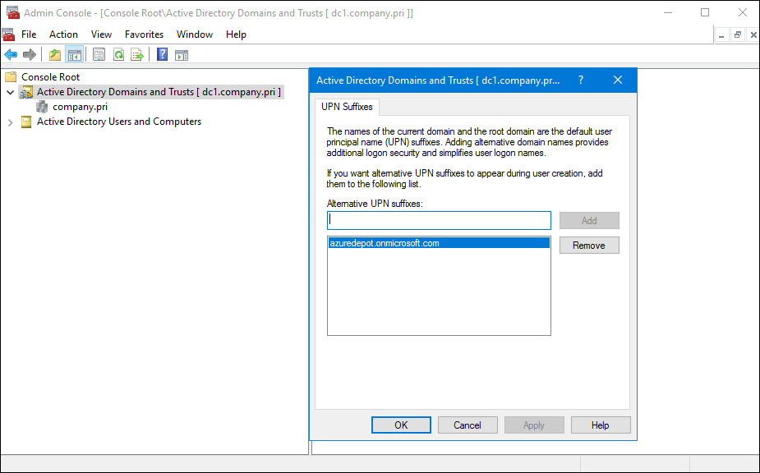
You may need to tweak UPN suffixes in Active Directory to foster "SSO"

Slide 27
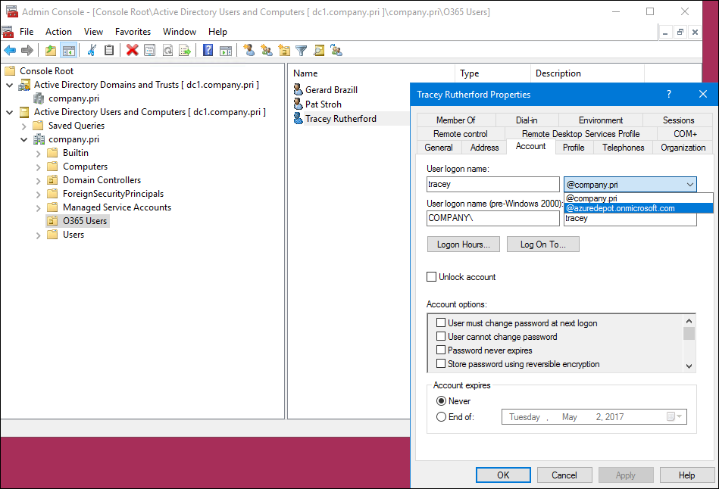
You can script mundane tasks like this by using PowerShell

Slide 28
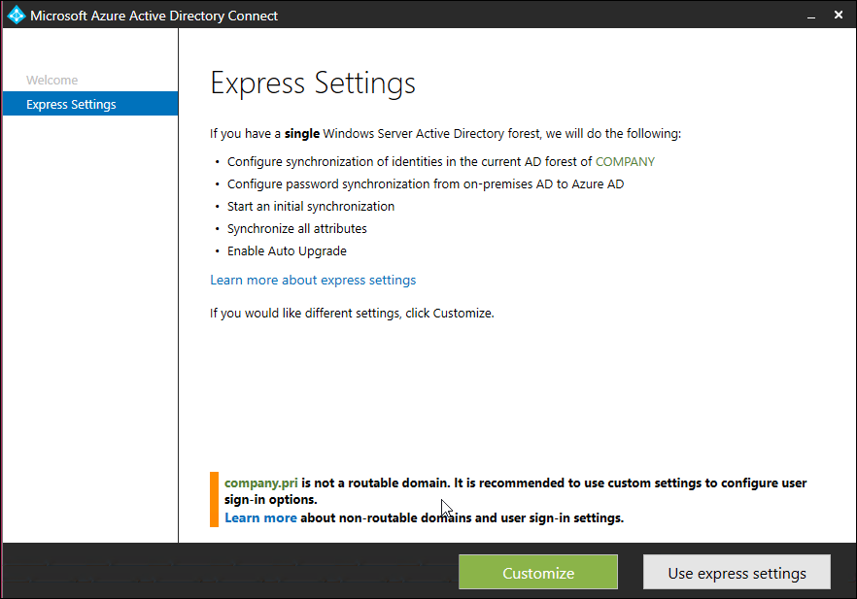
Express is for simple password sync
Customize is for advanced options

Slide 29
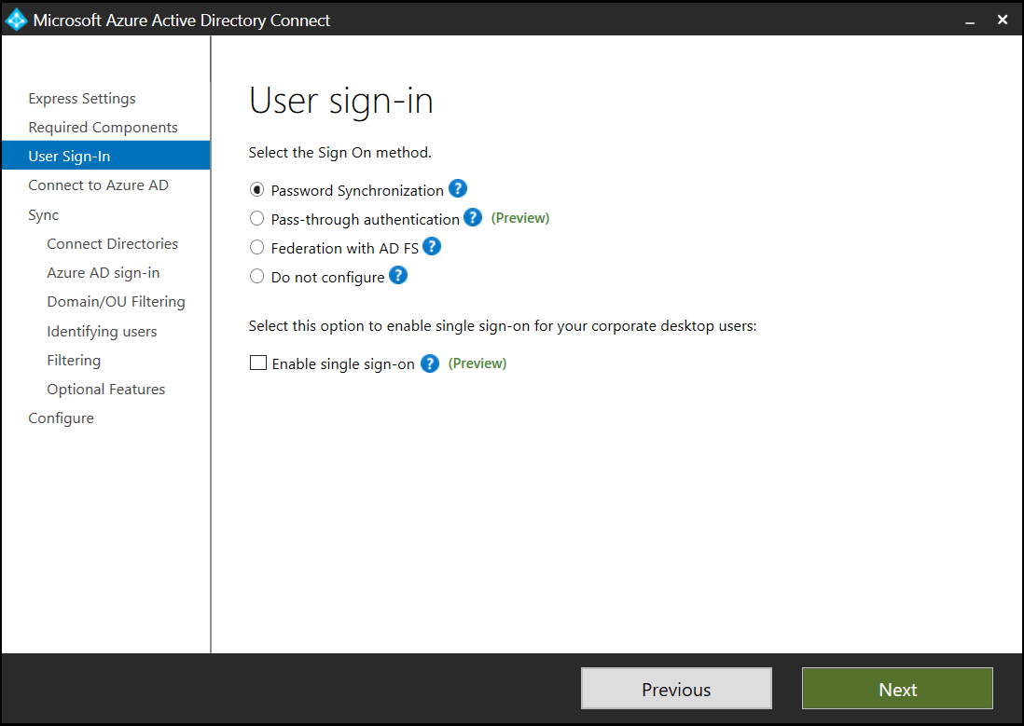

Slide 30
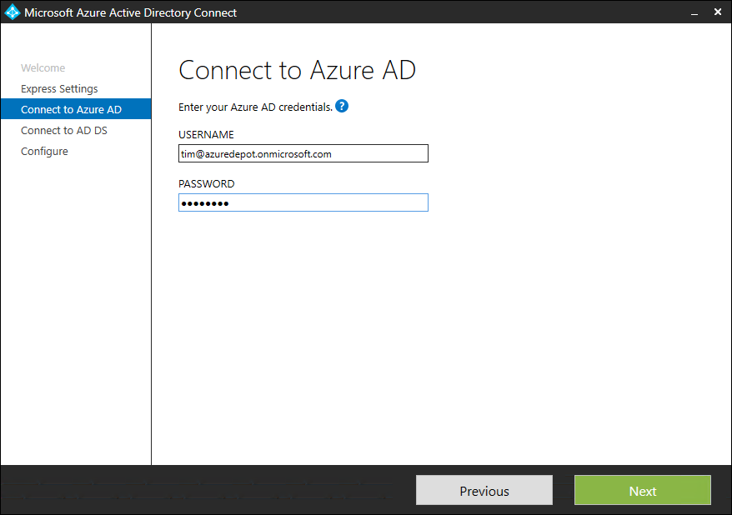
Authenticate as an Office 365 global admin

Slide 31
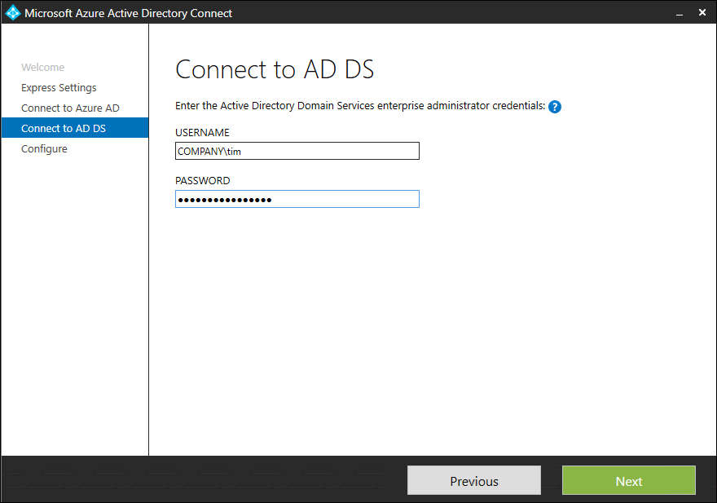
Authenticate as an AD DS enterprise admin

Slide 32
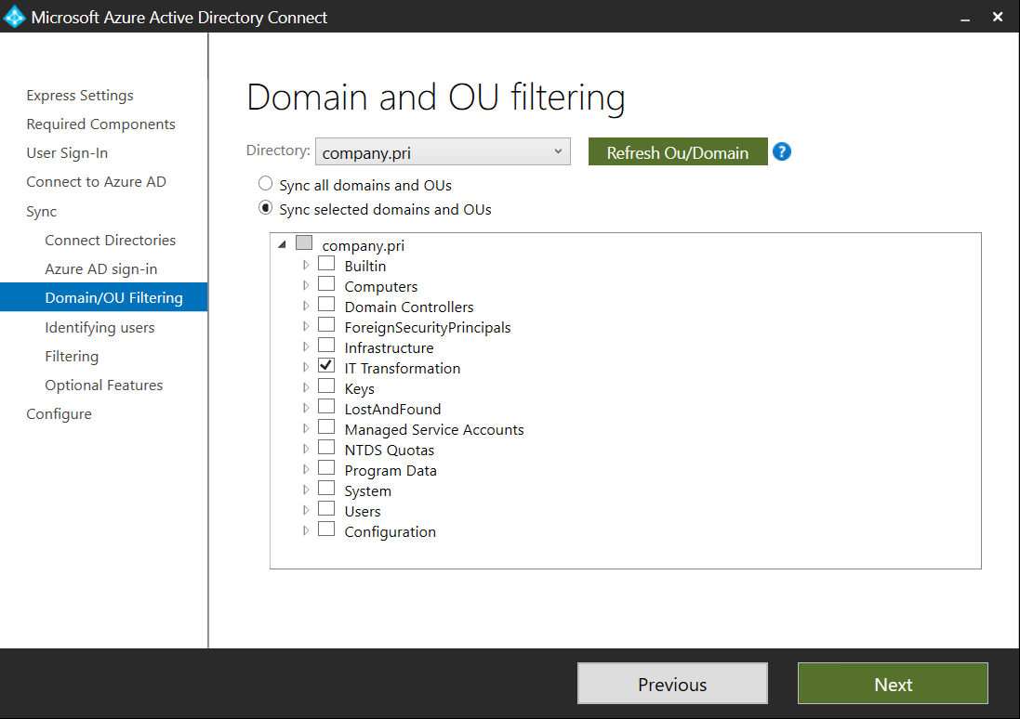
The Customize option gives you far greater control

Slide 33
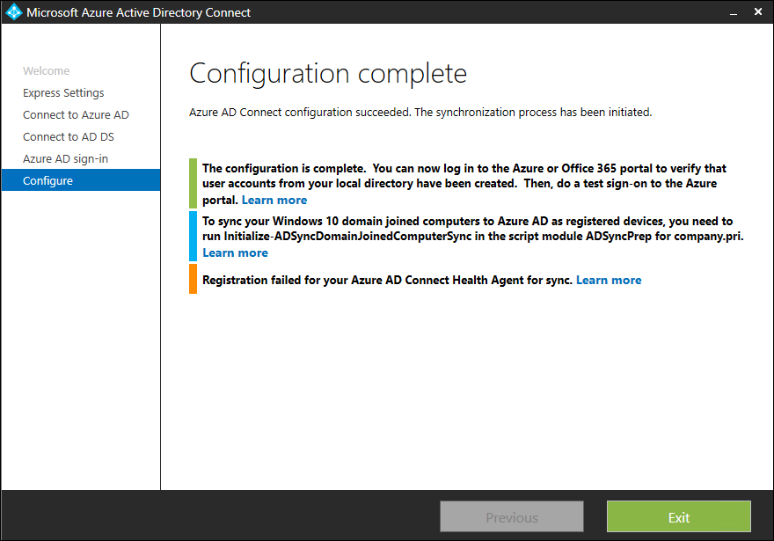

Slide 34
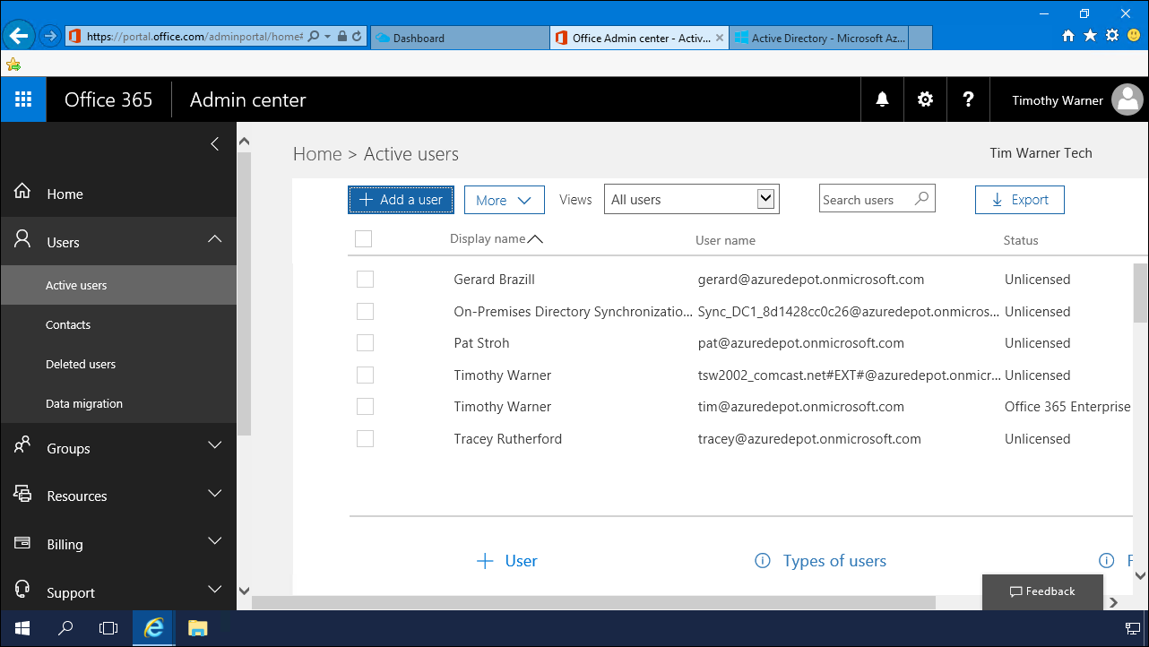

Slide 35
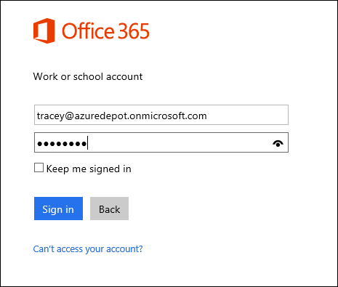
Users authenticate with their "e-mail address" and their on-prem password

Slide 36
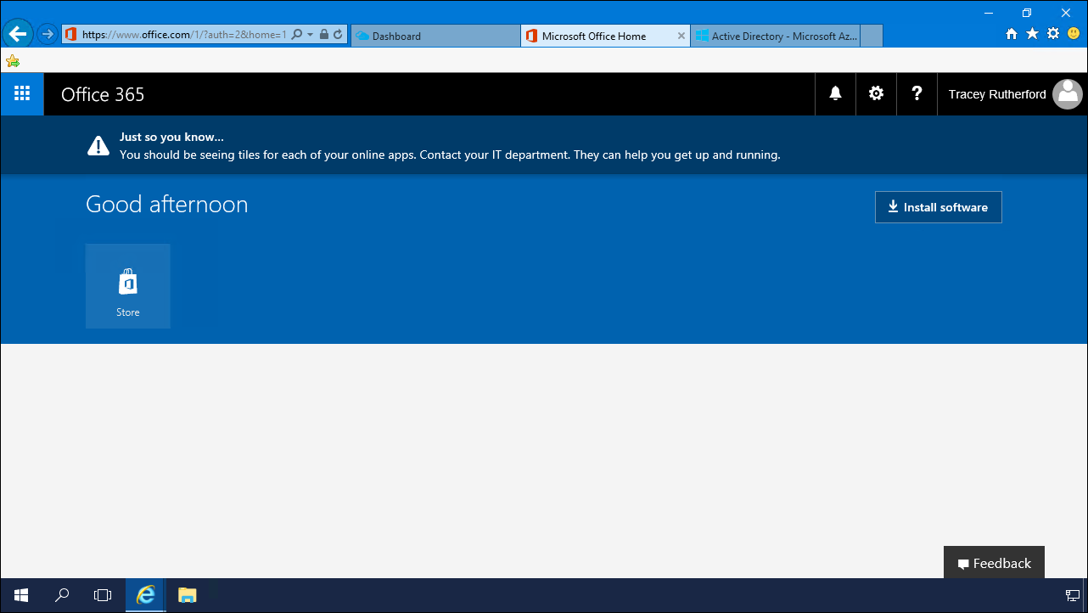
This user hasn't been licensed for Office 365 yet

Slide 37
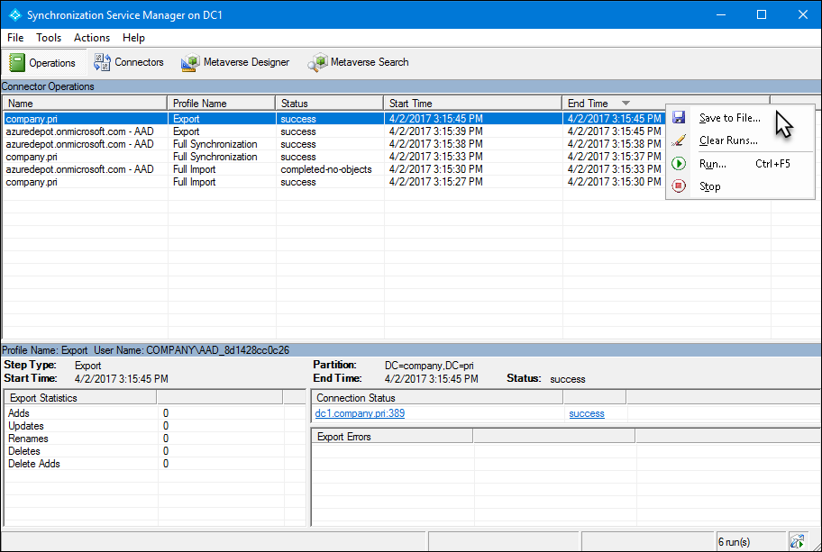
Audit and tweak password synchronization

Slide 38
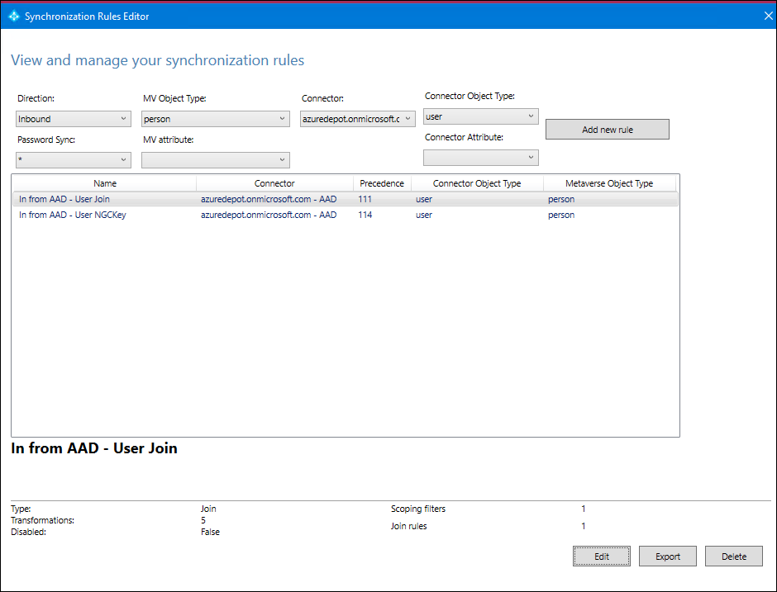
Map AD schema attributes with cloud ID attributes

Slide 39
Synchronized ID Example 2 of 2: On-Prem-to-Azure AD-to-SaaS

Slide 40
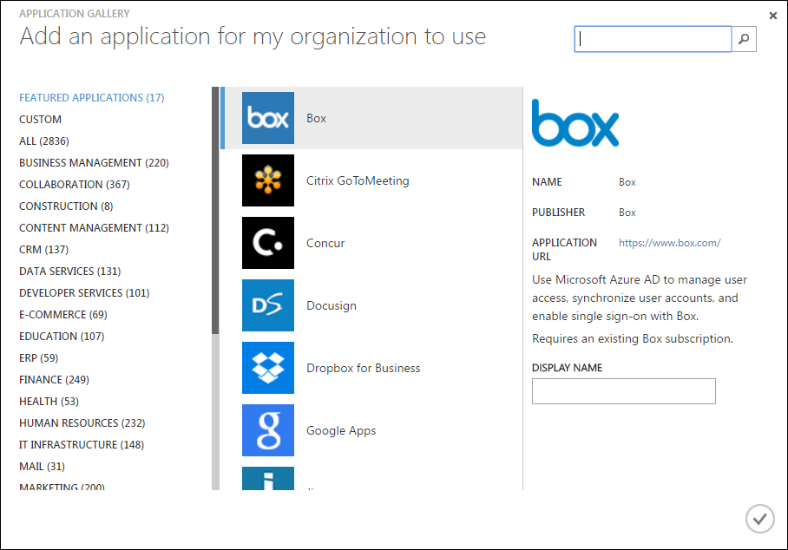
Application Gallery

Slide 41
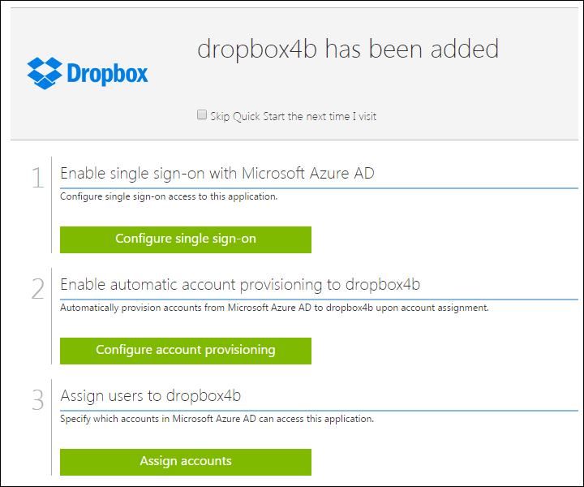
“Turnkey” SaaS App Integrations

Slide 42
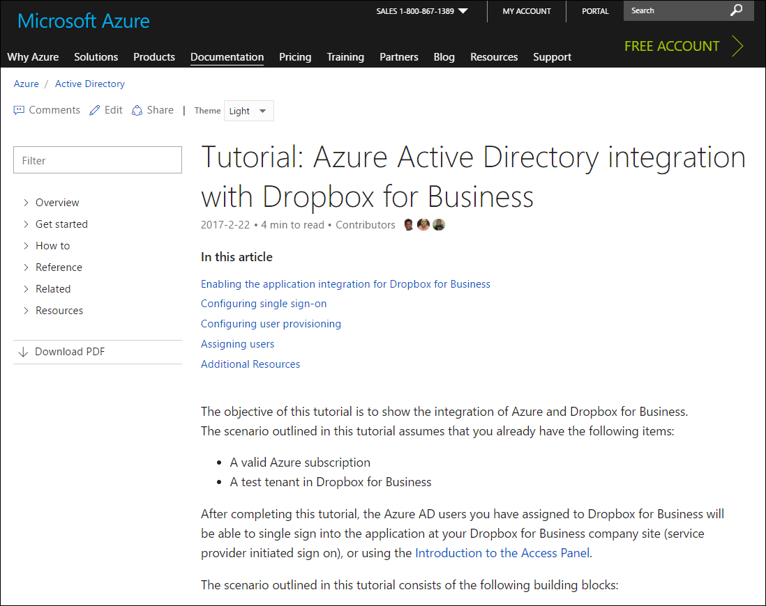
docs.microsoft.com/azure

Slide 43
Let’s Investigate Azure SaaS Integrations!

Slide 44

Review
Do you use Office 365?
Azure AD Connect
Does Azure have a built-in SaaS integration?
Read the docs and deploy
Is identity federation truly necessary?
Azure AD Connect & AD FS
Third-party IdP solution provider

Slide 45
Questions?
Please use Events XD (EventBoard) to fill out a session evaluation.
Thank you!
timw.info/itt
@TechTrainerTim

